Slide 1
INTELLIGENCE OF BIOLOGICAL SYSTEMS-2
​​
PROJECT TOPIC
MOTIF DISCOVERY: GREEDY MOTIF SEARCH

Slide 2
GROUP MEMBERS
NIRANJAN PRASANTH (AM.EN.U4.AIE21148)
ASWIN US (AM.EN.U4AIE21119)
AKSHAY KRISHNAN T (AM.EN.U4AIE21109)
NAVNEETH SURESH (AM.EN.U4AIE21147)
MUHAMMED SHAJAHAN (AM.EN.U4AIE21144)
GROUP 1

Slide 3
TOPIC OUTLINE
INTRODUCTION
METHODOLOGY
ALGORITHM DESIGN
CODE/DEMO AND RESULTS OBTAINED
CONCLUSION

Slide 4
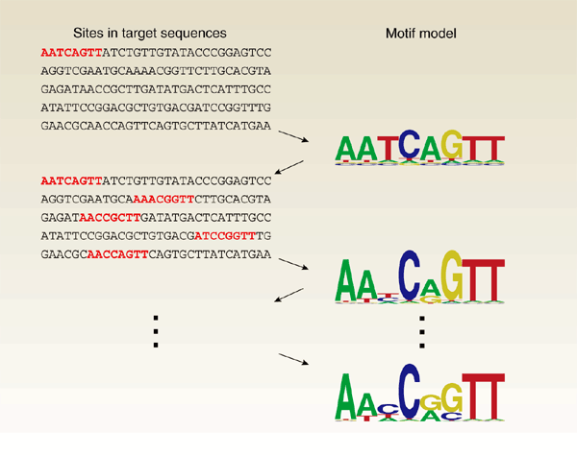
INTRODUCTION
WHAT ARE MOTIFS?
Motif is the transcription factor binding site
where the transcription factor binds in our
DNA sequence. These motifs are very useful
as they are helpful in the treatment of
various genetic diseases which were previously
considered as incurable.

Slide 5
TRANSCRIPTION FACTOR
The transcription factors are the genes which regulates the rate of transcription of the genetic information from DNA to mRNA, this is done with the help of these genes getting attached to their binding sites called the transcription factor binding site also called motifs.
In the computational approach we will be considering motifs as a short recurring patterns in DNA which are biologically important.
GREEDY SEARCH
A greedy algorithm is an approach for solving a problem by selecting the best option available at the moment. In motif discovery, The basic idea of the greedy motif search algorithm is to find the set of motifs across a number of DNA sequences that match each other most closely. ​

Slide 6
For performing this:
we run through each possible k-mer in our first DNA string.​
Identify the best matches for this initial k-mer within each of the following DNA strings, thus creating a set of motifs at each step​
Score each set of motifs to find and return the best scoring set.
​Basically ,greedy algorithm chooses the best in each stage with no backtracking and local solution is obtained and not an exhaustive search(means it does not go search for all possibilities, instead it will just consider one or two initial possibilities and come at a solution.
It uses less time and results closely resembles the known Motifs

Slide 7
LAPLACE RULE OF SUCCESSION
According to the Laplace rule of succession if we encounter any zeros in the profile matrix then we create a pseudo count of the present profile matrix and then we go on calculation the score of the k-mer. we are able to handle the zeros present in the profile matrix with the concept of Cromwell's rule of statistical maxim, which states that the probability of occurrence of the most unlikely events also exists and can not be considered to be zero.

Slide 8
methodology
INPUTS: DNA Sequence, k length
Forming the DNA matrix
If set of DNA or single string DNA is given, to make the process easier we will be converting that into a matrix by dividing DNA at equal intervals of equal width.
Selecting the 1st seen k-mers to create a profile matrix
We are taking 1st seen n number of k-mers from the DNA matrix and storing into a matrix. Then a count matrix and then profile matrix is formed based on that. Here profile matrix is just an evaluation criterion. Profile matrix can also be described as the normalised version of count matrix.

Slide 9
Selecting the k-mer (Motif_1) with highest score from the 1st row
The profile obtained earlier is used to evaluate each kmer in the 1st row of the
DNA matrix.
From the values obtained, one with the highest score is taken and that will be our 1st Motif and is added to the motif matrix
Updating the Motif matrix with a new motif (i):-
1st motif will get added, ie the motif matrix now have only one entry. This profile matrix will be used to evaluation of the k-mer with highest score in 2nd Row of the DNA matrix just like we did for the 1st row.
Thus we will get a motif and that is added to the motif matrix

Slide 10
Repeating this step for every other row:-
Returning the motif matrix which will contain
Motif_1
Motif _2
….
Output: A set of similar patterns.

Slide 11
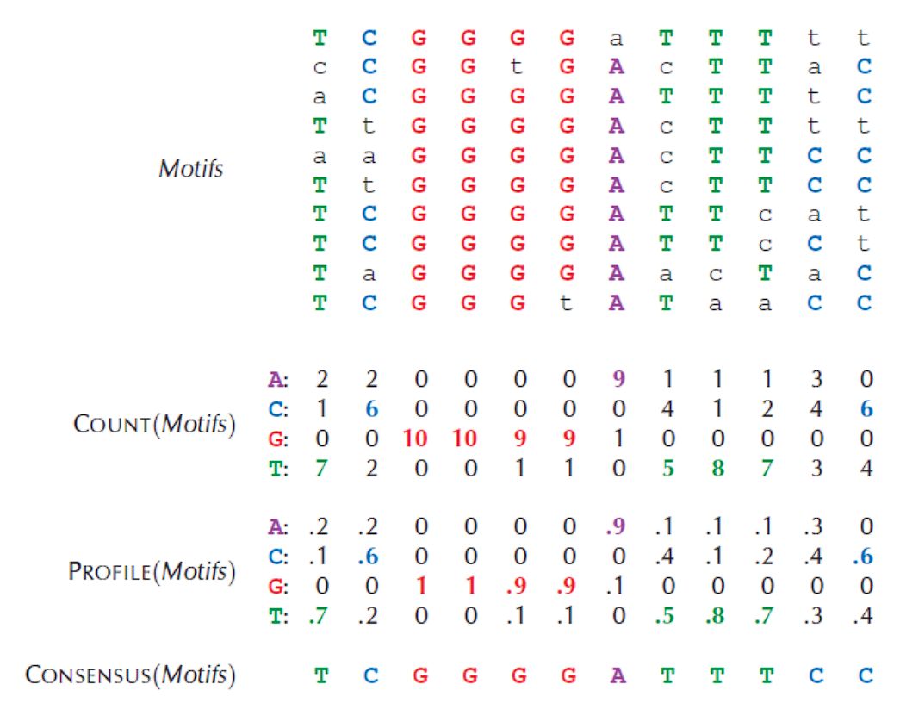

Slide 12
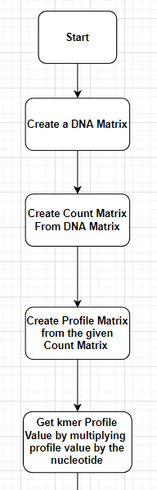
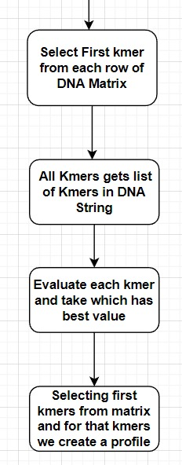

Slide 13
Algorithm :-
Greedy Motif Search Algorithm
Our proposed greedy motif search algorithm, GreedyMotifSearch, tries Run through each possible k-mer in our first dna string.​
Identify the best matches for this initial k-mer within each of the following dna strings, thus creating a set of motifs at each step​
Score each set of motifs to find and return the best scoring set.​

Slide 14
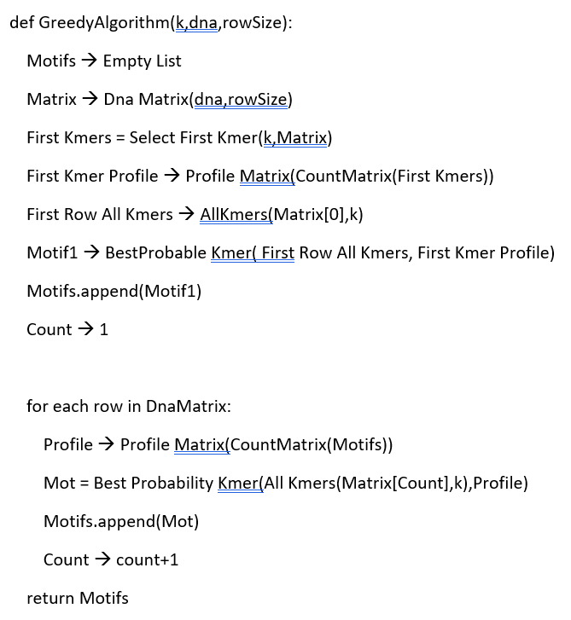
PSEUDOCODE

Slide 15
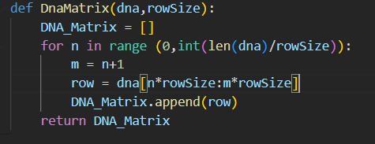
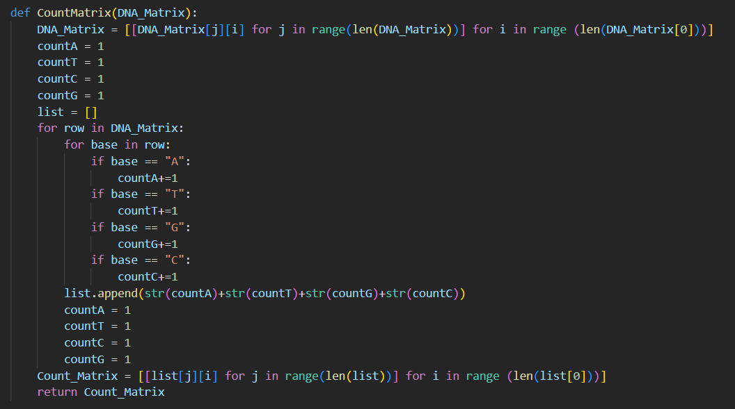
At first, the functions were defined:.
Here, the function to create a DNA matrix and it will loop through that cuts the DNA at a desired row size and will append to the rows
Then we create a function CountMatrix, in which the matrix can Only be created only if a DNA Matrix exists. We initialize counters and increment values accordingly and append to list, then we take transpose and return the count matrix .

Slide 16
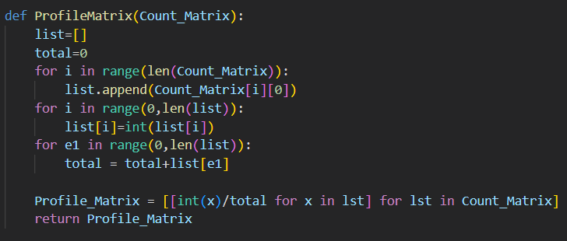
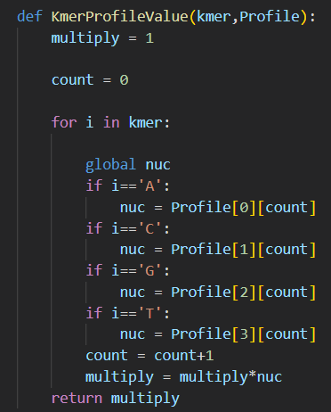
Function to create profile matrix which is the normalized version of Count matrix.
Then we create a function KmerProfileValue, which basically is, if there is a kmer of a specific k value and a profile matrix and it takes value from profile matrix and it multiplies and store the value and returns the result for that specific kmer

Slide 17
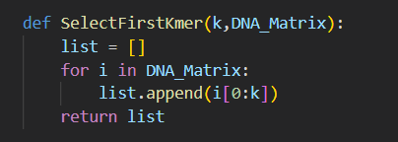
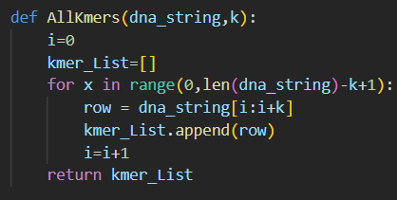
Here is where the greedy part starts, we have to select the first kmer from each row of DNA Matrix.
Here if we give a dna string and length k which are all possible kmers , here to get the last kmer we use the above code length of
dna string - (k+1)

Slide 18
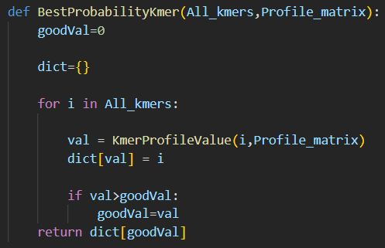
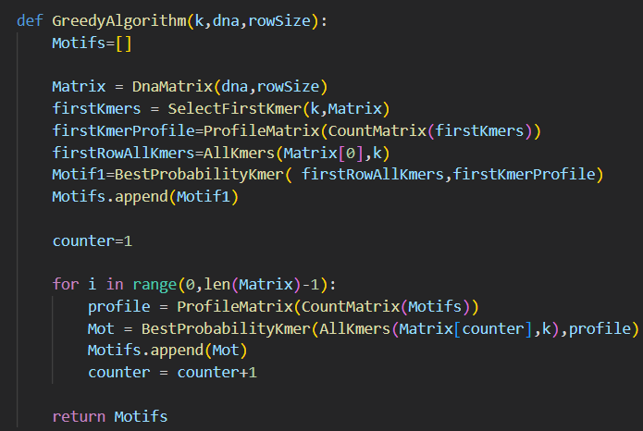
The best kmer is selected based on profile value
This is the main function where we create a main DNA matrix
We select the first kmers from that matrix and we create a profile
for that kmers

Slide 19
Greedy Motif Search Advantages
Takes less time to find the solution. It is best applicable when one needs a solution in real-time and approximate answers are “good enough.
Greedy Motif Search Disadvantages
No guarantee of finding an optimal solution. Early choices may lead to wrong directions .​
Result depends on the initial random motif ​
Good result is unlikely in a single run . Run algorithm many times and hope that one of the runs gives a good result​.

Slide 20
CONCLUSIONS
Even though Programmable implementation of the Greedy Motif Algorithm was successful, it is seen that they have a polynomial time complexity of O (ln2 + nlt) where l is the length of the motif, n is the length of the DNA samples, and t is the number of DNA samples. Many times results are dependent on the initial random motif and it is unlikely to get a good result in a single run. Greedy algorithm is a good method to find motifs approximately but since it is looking one step at a time, it is not a good method compared to available options.

Slide 21
THANK YOU

